Slide 1

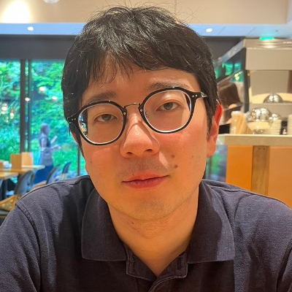

Fully Adaptive Decentralized MA-ABE: Simplified, Optimized, ASP Supported
Pratish Datta
NTT Research
Junichi Tomida
NTT Research
Nikhil Vanjani
Carnegie Mellon University
eprint: 2025/1628
Notes:
Section 0: 12:00 min.
Section 1: 29:00 min (17:00 min).
Section 2: 34:00 min (4:30 min).
Section 3: 59:00 min (25:00 min).
CMU crypto seminar times:
Section 0: 20:00 min (including discussion on ASP slide and questions)
Section 1: 37:00 min (based on estimate of 17:00 min)
Section 2: 42:00 min (based on estimate of 5:00 min)
Section 3: finished SD assumption slides by 50:00min. Skimmed over hybrids by 57:00 min. Finished talk by 62:00 min.

Slide 2







Attribute-based Encryption (ABE) [SW05, GPSW06]
Decrypt?
CS, Professor
✅
CMU
pk, msk
CS, Student
❌
msg
CS ^ Professor
ECE, Professor
❌
ECE, Student
❌
Notes:
Acess control is a fundamental problem in computer security, where the goal is to ensure only authorized users can access certain data.
Attribute-Based Encryption (ABE) addresses this challenge by binding ciphertexts to access policies and decryption keys to user attributes.
Consider a university such as CMU where we want to enforce access control based on user attributes.
In this scenario, CMU acts as a central trusted authority and holds the public key and master secret key of the system.
Anyone can encrypt a message in the system with respect to a ciphertext-policy, such as CS ^ Professor.
Suppose there is a user who has both these attributes, then, he can obtain decryption keys for these attributes from the authority.
Similarly, other users can obtain decryption keys corresponding their attributes as well.
Correctness requires that the first user can decrypt the ciphertext. Security requires that other users should not be able to since their attributes don’t match the policy.
Moreover, security should against colluduing users. For example, if users 2 and 3 collude, then, even though their joint attributes satisfy the policy, they should not be able to decrypt the ciphertext.
0:20

Slide 3

Centralized trust
CMU
pk, msk
Notes:
While ABE as a primitive has been extensively studied over the past two decades, it’s trust assumption of a centralized authority is a critical barrier to large-scale deployment. For instance, if someone steals the keys of the central authority, then no security is left in the system.
1:45

Slide 4
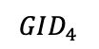
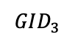
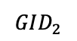
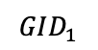
Decentralized Multi-Authority ABE [Cha07, LW11]
CS
Decrypt?
global params
pk, msk
Professor
CS, Professor
$$GID_{1}$$
✅
pk, msk
ECE
CS, Student
❌
$$GID_{2}$$
pk, msk
msg
ECE, Professor
❌
Student
$$GID_{3}$$
CS ^ Professor
pk, msk
ECE, Student
$$GID_{4}$$
❌
Notes:
Chase [Cha07] introduced the concept of Multi-Authority Attribute-Based Encryption (MA-ABE), which enables multiple independent authorities to concurrently manage disjoint sets of attributes.
Here, global public parameters are generated once at the beginning. Using global params, each authority, such as CS, Profesor, ECE, Student can generate their authority keys. For sake of simplicity here, let’s assume that each authority controls one attribute each.
Encryption now requires public keys of all the attributes appearing in the policy.
Suppose a user possesses attributes CS and professor. Then, it can obtain decryption keys from respective authorities for the same. Crucially, this does not require co-ordination among the two authorities. This feature is enabled by associating Global identifiers, or GIDs with each user.
Similarly, other users can obtain their keys. Correctness requires like before that the user with GID1 should be able to decrypt, while others should not be.
2:05

Slide 5
MA-ABE security
CS
Decrypt?
global params
pk, msk
Professor
CS, Professor
$$GID_{1}$$
pk, msk
ECE
CS, Student
$$GID_{2}$$
pk, msk
❌
msg
ECE, Professor
Student
$$GID_{3}$$
CS ^ Professor
pk, msk
ECE, Student
$$GID_{4}$$
Notes:
Similar to standard ABE, Multi-Authority ABE naturally demands collusion resistance against unauthorized users
3:30

Slide 6
MA-ABE security
CS
Decrypt?
global params
pk, msk
Professor
CS, Professor
$$GID_{1}$$
pk, msk
ECE
CS, Student
$$GID_{2}$$
pk, msk
msg
ECE, Professor
Student
$$GID_{3}$$
CS ^ Professor
pk, msk
❌
ECE, Student
$$GID_{4}$$
Notes:
however, MA-ABE introduces an additional challenge: the possibility that some attribute authorities themselves may become corrupted and collude with malicious users. For example, the collusion of authorities Professor, ECE, Student and users with GID3 and 4 should still not be able to decrypt the ciphertext.
Addressing this critical security aspect, prior works have formalized various corruption models such as no corruption, static corruption, adaptive corruption.
3:40

Slide 7
State-of-the-art in MA-ABE
Policy
Class
Decentralized?
User
Corruption
Authority
Corruption
Proof Technique
[LW11a]
✅
adaptive
static
Simple (Dual System)
boolean span program (BSP)
[DKW23]
✅
adaptive
adaptive
Complex (Dual System with dual sub-systems)
Notes:
Lewko and Waters proposed the first truly decentralized MA-ABE scheme and used dual system encryption techniques to prove security. But, they could only support static corruption of authorities. Given the inherently decentralized and dynamic nature of MA-ABE, such assumption seems overly restrictive and unrealistic.
Supporting adaptive corruptions remained a long-standing open-problem and after more than a decade, Datta, Komargodski and Waters made progress on this question and introduced the first fully adaptive MA-ABE scheme in 2023. Subsequent work of Chen et al showed how to support attribute-reuse in the policy. However, the proof technique in these works is quite complex and uses dual system with dual sub-systems. This results in an inefficient scheme compared to Lewko-Waters.
4:15

Slide 8
Main Question
Can we design a fully adaptive decentralized
MA-ABE for BSP without two subsystems?
Notes:
Thus, the central questions that we study in this work are as follows:
…
All works on MA-ABE so far are studied in a Boolean model of computation. A second question we ask is can we design a decentralized MA-ABE for an arithmetic model of computation?
5:15

Slide 9
Our Main Result in [DTV25a]
Fully Adaptive Decentralized MA-ABE for BSP
without two subsystems
1
Lewko–Waters [LW11a] scheme is full adaptive secure !!
New security proof
✅ Conceptually simpler and tighter security analysis
✅ Efficiency gain in both computational and communication costs
compared to [DKW23]
Notes:
Our contributions are as follows.
First, we present a fully adaptive decentralized MA-ABE for BSP with simpler proof and improved efficiency.
In particular, we show that the celebrated construction of Lewko and Waters is in fact full adaptive secure, meaning it can handle adaptive corruptions. Towards this, we provide a new security proof, which is conceptually simpler than prior state-of-the-art and is a tighter security analysis.
A byproduct of this advancement is that our scheme achieves significant efficiency gains in both computation and communication costs.
5:30

Slide 10
Other Contributions in [DTV25a]
Decentralized MA-ABE for Arithmetic Span Program (ASP)
2
Construction and proof build upon our framework for BSP
✅ adaptive corruption of arbitrarily many user secret keys
🫤 adaptive corruption of authorities with restrictions
Fundamental barriers
Notes:
Our second contribution is the first decentralized MA-ABE scheme for Arithmetic Span Programs (ASPs).
The construction and proof build upon our framework for BSP.
We are able to support adaptive corruption of arbitrarily many user secret keys.
While we can handle adaptive corruption of authorities, this comes with some restrictions which arise due to what we perceive to be fundamental barriers for supporting ASP in the multi-authority setting.
6:00

Slide 11

1
Lewko-Waters MA-ABE for BSP
Limitations in supporting adaptive authority corruption
Our key idea
2
Security Analysis
3
Our MA-ABE for ASP
Notes:
Section 0: 10:56 min.
Section 1: 29:00 min (17:00 min).
Section 2: 34:00 min (4:30 min).
Section 3: 59:00 min (25:00 min).
6:30

Slide 12
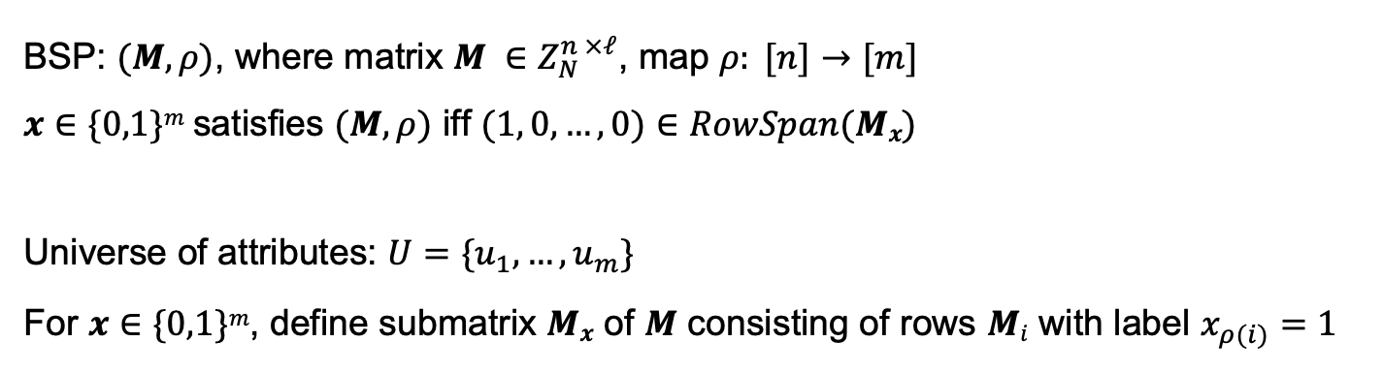
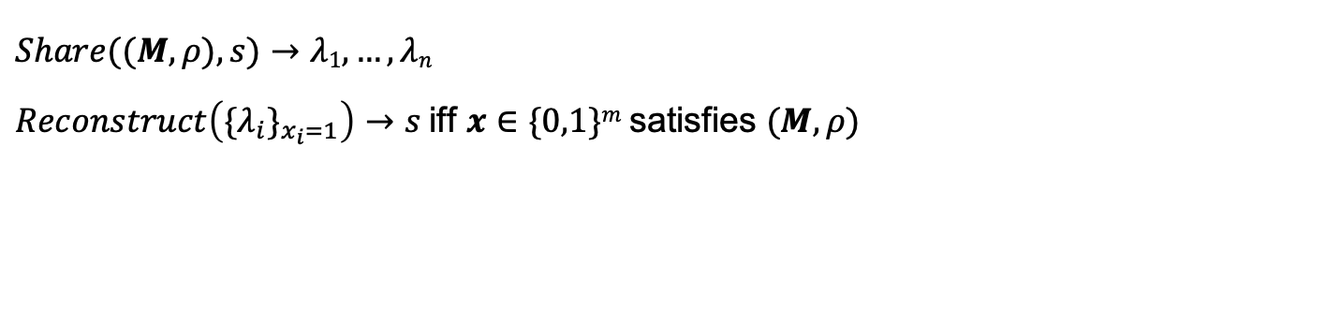
Boolean Span Program (BSP)
BSP: $(M, ρ)$, where matrix $M ∈Z_{N}^{n ×ℓ}$, map $ρ: [n]→[m]$ $x∈\{0,1\}m$satisfies $(M, ρ)$ iff $(1, 0, …, 0)∈RowSpan(Mx)$ Universe of attributes: $U=\{u_{1}, …,u_{m}\}$ For $x∈\{0,1\}m$, define submatrix $Mx$ of $M$ consisting of rows $Mi$ with label $x_{ρ(i)}=1$
Linear Secret Sharing Schemes (LSSS)
$$Share((M, ρ), s)→λ1, …, λn$$ $Reconstruct\left({\{λ}_{i}\}_{x_{i}=1}\right)→s$iff $x∈\{0,1\}m$satisfies $(M, ρ)$
Notes:
A BSP is denoted by a pair (M, rho) of a matrix M and a labeling function rho that labels each of the n rows of the matrix with one of the m attributes in the universe. For the scope of this talk, you can imagine rho is an identity function for simplicity.
BSP on input a bit-string x outputs 1 iff (1, 0, …, 0) \in RowSpan(M_x).
A secret sharing scheme consists of a pair of share generation and reconstruction algorithm. Here, we generate n shares lambda_1, …, lambda_n of the secret s with respect to a BSP access policy. You can think that i-th share corresponds to i-th row of the matrix. Reconstruction allows to recover s if the bit-string x corresponding to the shares satisfy the policy.
7:10

Slide 13

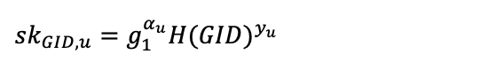
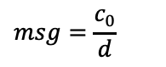

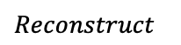
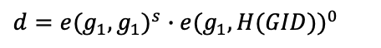
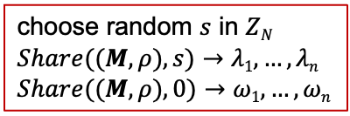
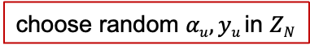
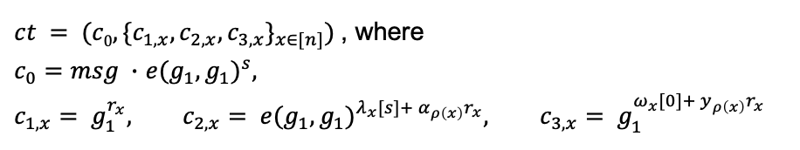
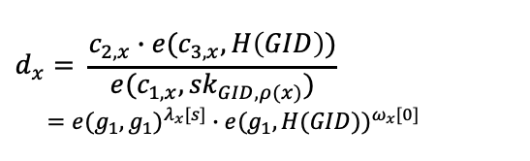

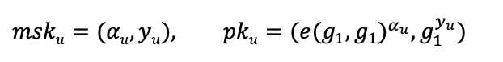
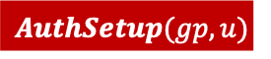

Lewko-Waters MA-ABE for BSP construction
$$msku=(αu, yu), pku=(e(g_{1}, g_{1})^{α_{u}}, g_{1}^{y_{u}})$$
$$GlobalSetup(1κ)$$
$$Dec(ct,\{sk_{GID,ρ(x)}\}_{ρ(x)∈S})$$
$$gp = (N=p1p2p3, G, G_{T}, e, g1, H: \{0,1\}^{∗}→G)$$
$$d_{x}= \frac{c_{2,x}∙e(c_{3,x}, H\left(GID\right))}{e(c_{1,x}, {sk}_{GID,ρ(x)})} \\ =e(g_{1}, g_{1})^{λ_{x}[s]}∙e(g_{1}, H(GID))^{ω_{x}[0]}$$
$$AuthSetup(gp, u)$$
choose random $αu, yu$in $ZN$
$$KGen(msk_{u}, GID)$$
$$Reconstruct$$
$$sk_{GID,u}=g_{1}^{α_{u}}H(GID)^{y_{u}}$$
$$d=e(g_{1}, g_{1})^{s}∙e(g_{1}, H(GID))^{0}$$
$$Enc((M∈Z_{N}^{n × ℓ}, ρ), msg∈G_{T})$$
choose random $s$ in $ZN$
$$Share((M, ρ), s)→λ1, …, λn$$
$$Share((M, ρ), 0)→ω1, …,ωn$$
$$msg=\frac{c_{0}}{d}$$
$ct = (c0, \{c_{1,x},c_{2,x}, c_{3,x}\}_{x∈[n]})$ , where
$c_{0}=msg ∙$ $e(g_{1}, g_{1})^{s}$,
$$c_{1,x}= g_{1}^{r_{x}}, c_{2,x}= e(g_{1}, g_{1})^{λ_{x}[s]+ α_{ρ\left(x\right)}r_{x}}, c_{3,x}= g_{1}^{ω_{x}[0]+ y_{ρ\left(x\right)}r_{x}}$$
Notes:
8:40

Slide 14
Proof Technique: Dual System Encryption [W’09]
 | Normal user secret key | Semi-functional user secret key
Normal ciphertext | ✅ | ✅
Semi-functional ciphertext | ✅ | ❌
Notes:
11:40

Slide 15
Proof Technique: Dual System Encryption [W’09]
 | Normal user secret key | Semi-functional user secret key
Normal ciphertext | ✅ | ✅
Semi-functional ciphertext | ✅ | ❌
Ciphertext
User secret keys
Last step: ciphertext encrypts random message
Notes:
12:10

Slide 16
Limitation: Static Authority Corruption
Penultimate step: ciphertext, all user secret keys: semi-functional
Last step: ciphertext encrypts random message
Target-group-based computational assumption (DBDH variant)
Reduction embeds challenge in public keys of honest authorities
Notes:
12:40

Slide 17
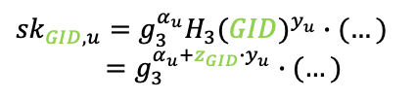
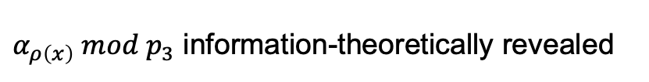
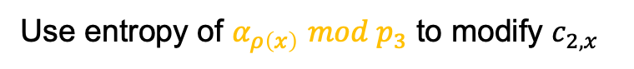
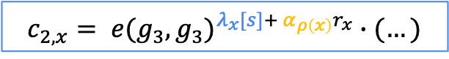
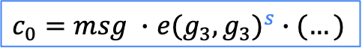
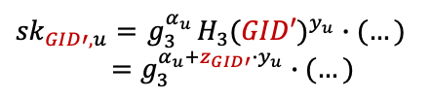
Towards Adaptive Authority Corruption
Penultimate step: ciphertext, all user secret keys: semi-functional
Last step: ciphertext encrypts random message
Make this transition information-theoretic
Want
Idea
Break correlation between $c_{0}$ and $c_{2,x}$ and use entropy of $s$ $mod p_{3}$
$c_{0}=msg ∙$ $e(g_{3}, g_{3})^{s}∙(…)$
$$c_{2,x}= e(g_{3}, g_{3})^{λ_{x}[s]+ α_{ρ\left(x\right)}r_{x}}∙(…)$$
How
Use entropy of $α_{ρ\left(x\right)}$ $mod p_{3}$ to modify $c_{2,x}$
$${sk}_{GID,u}=g_{3}^{α_{u}}H_{3}(GID)^{y_{u}}∙(…)$$
$$=g_{3}^{α_{u}+z_{GID}∙y_{u}}∙(…)$$
$α_{ρ\left(x\right)} mod p_{3}$ information-theoretically revealed
Problem
$${sk}_{GID′,u}={ g}_{3}^{α_{u}}H_{3}(GID′)^{y_{u}}∙(…)$$
$$=g_{3}^{α_{u}+z_{GID′}∙y_{u}}∙(…)$$
Notes:
13:10

Slide 18

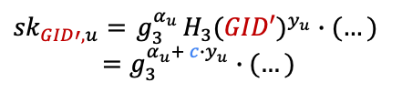
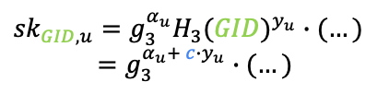
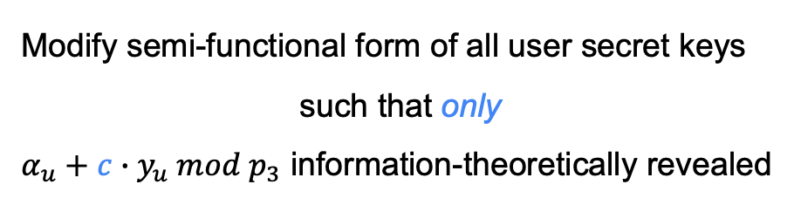
Towards Adaptive Authority Corruption
Penultimate step: ciphertext, all user secret keys: semi-functional
Last step: ciphertext encrypts random message
Make this transition information-theoretic
Want
Modify semi-functional form of all user secret keys
such that only
$α_{u}+c∙y_{u} mod p_{3}$ information-theoretically revealed
Our Main Idea
$${sk}_{GID,u}=g_{3}^{α_{u}}H_{3}(GID)^{y_{u}}∙(…)$$
$$=g_{3}^{α_{u}+ c∙y_{u}}∙(…)$$
$${sk}_{GID′,u}={ g}_{3}^{α_{u}}H_{3}(GID′)^{y_{u}}∙(…)$$
$$=g_{3}^{α_{u}+ c∙y_{u}}∙(…)$$
Notes:
15:10

Slide 19
Also in the paper
Summary
Lewko-Waters MA-ABE for BSP is fully secure
New proof techniques ➔ Simplified and Efficient construction
MA-ABE for BSP
Security proof details
Asymmetric prime-order bilinear group construction
Extension to attribute-reuse
MA-ABE for ASP
Construction
Barrier for handling full adaptive corruption of authorities
Notes:
16:40

Slide 20
Open Questions
Making MA-ABE practical
Real-World
access policy
MA-ABE-friendly
intermediate representation
MA-ABE
implementation
Overhead 1
Overhead 2
Computation model
Attribute reuse in policy?
# attributes per
policy or user
BSP
ASP
Circuits
Finite Automata
Turing Machine
RAM
One-use
Multi-use
Bounded
Unbounded
Security
Attribute-universe size
…
Fully adaptive
Small (poly)
Large (super-poly)
Notes:
17:20

Slide 21
Open Questions
Coming Soon: first constructions from standard assumptions on
Pairings [DTV25b], Lattices [DRTV25]
Making MA-ABE practical
Real-World
access policy
MA-ABE-friendly
intermediate representation
MA-ABE
implementation
Overhead 1
Overhead 2
Computation model
Attribute reuse in policy?
# attributes per
policy or user
BSP
ASP
Circuits
Finite Automata
Turing Machine
RAM
One-use
Multi-use
Bounded
Unbounded
Security
Attribute-universe size
…
Fully adaptive
Small (poly)
Large (super-poly)
Notes:
18:20

Slide 22


eprint: 2025/1628
1 hour talk
Thank You!
nikhilvanjani61@gmail.com
Notes:
18:50

Slide 24
Challenges towards making MA-ABE practical
Real-World
access policy
MA-ABE-friendly
intermediate representation
MA-ABE
implementation
Overhead 1
Overhead 2
Computation model
Attribute reuse in policy?
# attributes per
policy or user
BSP
ASP
circuits
Finite Automata
Turing Machine
RAM
One-use
Multi-use
Bounded
Unbounded
Security
Attribute-universe size
…
Fully adaptive
Small (poly)
Large (super-poly)
Notes:
4:55

Slide 25
Challenges towards making MA-ABE practical
Our Contributions: [DTV25a]
Real-World
access policy
MA-ABE-friendly
intermediate representation
MA-ABE
implementation
Overhead 1
Overhead 2
Computation model
Attribute reuse in policy?
# attributes per
policy or user
BSP
ASP
circuits
Finite Automata
Turing Machine
RAM
One-use
Multi-use
Bounded
Unbounded
Security
Attribute-universe size
…
Fully adaptive
Small (poly)
Large (super-poly)
Notes:
6:56

Slide 27
Communication costs*
Scheme | Policy class | |msk_{u}| | |pk_{u}| | |sk_{u, GID}| | |ct|
DKW23 | BSP | 18 |Z_{q}| | 6 |G₁| | 6 |G₂| | 12n |G₁|
This work | BSP | 12 |Z_{q}| | 6 |G₁| | 2 |G₂| | 8n |G₁|
This work | ASP | 24 |Z_{q}| | 12 |G₁| | 2 |G₂| | 14n |G₁|
Size reduction
user secret key: 3x
ciphertext : 1.5x
* All instantiations from SXDH assumption on prime-order asymmetric pairing groups.
Notation. n: number of rows of BSP/ASP matrix
Notes:
9:56

Slide 28
Computation costs*
Scheme | Policy class | # exponentiations |  |  |  | # pairings
 |  | Auth Setup | KGen | Enc | Dec | Enc | Dec
DKW23 | BSP | (18)₁ | (18)₂ | (6n+12ln+6l−3)₁ + (3)_{T} | (|S|)_{T} | 3 | 12 |S|
This work | BSP | (12)₁ | (7)₂ | (14n)₁ + (1)_{T} | (3 |S|)₁ + (|S|)_{T} | 0 | 6 |S|
This work | ASP | (24)₁ | (7)₂ | (26n)₁ + (1)_{T} | (9 |S|)₁ + (|S|)_{T} | 0 | 6 |S|
2x fewer pairings
Time reduction
KGen: 2.6x
Enc : 1.3x
Dec : 1.7x
* All instantiations from SXDH assumption on prime-order asymmetric pairing groups.
Notation. n: number of rows of BSP/ASP matrix, l: number of columns, S: set of decryption attributes
Notes:
10:26

Slide 30
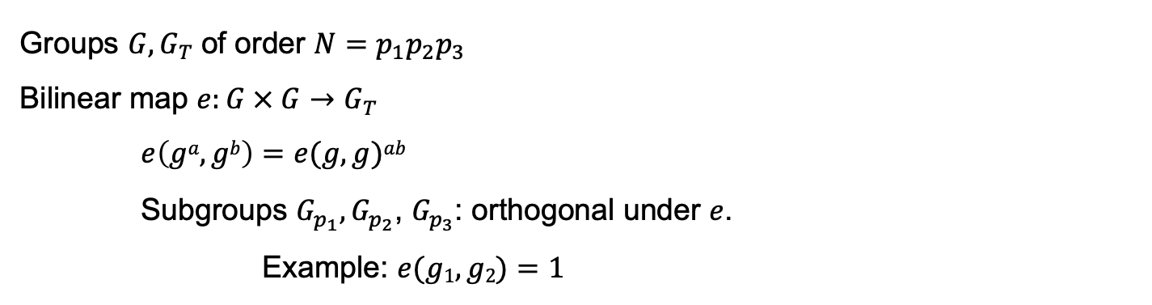
Composite-order pairing groups
Groups $G, G_{T}$of order $N=p_{1}p_{2}p_{3}$ Bilinear map $e:G × G→G_{T}$ $e\left(ga, gb\right)=e(g, g)ab$ Subgroups $G_{p_{1}},G_{p_{2}}$, $G_{p_{3}}$: orthogonal under $e$. Example: $e(g1, g2)=1$
Notes:
13:46

Slide 32
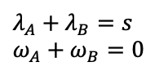
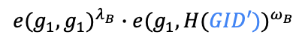
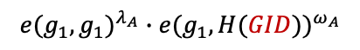
Security Intuition
$$Dec(ct,\{sk_{GID,ρ(x)}\}_{ρ(x)∈S})$$
AND
$$λ_{A}+λ_{B}=s$$
$$ω_{A}+ω_{B}=0$$
$$d_{x}= \frac{c_{2,x}∙e(c_{3,x}, H\left(GID\right))}{e(c_{1,x}, {sk}_{GID,ρ(x)})} \\ =e(g_{1}, g_{1})^{λ_{x}[s]}∙e(g_{1}, H(GID))^{ω_{x}[0]}$$
A
B
GID’
GID
$$Reconstruct$$
$$e(g_{1}, g_{1})^{λ_{A}}∙e(g_{1}, H(GID))^{ω_{A}}$$
$$e(g_{1}, g_{1})^{λ_{B}}∙e(g_{1}, H(GID′))^{ω_{B}}$$
$$d=e(g_{1}, g_{1})^{s}∙e(g_{1}, H(GID))^{0}$$
Incompatible!
$$msg=\frac{c_{0}}{d}$$
Notes:
18:46

Slide 34

Our MA-ABE for BSP construction: step 0 [LW11]
$$msku=(αu, yu), pku=(e(g_{1}, g_{1})^{α_{u}}, g_{1}^{y_{u}})$$
$$GlobalSetup(1κ)$$
$$Dec(ct,\{sk_{GID,ρ(x)}\}_{ρ(x)∈S})$$
$$gp = (N=p1p2p3, G, G_{T}, e, g1, H: \{0,1\}^{∗}→G)$$
$$d_{x}= \frac{c_{2,x}∙e(c_{3,x}, H\left(GID\right))}{e(c_{1,x}, {sk}_{GID,ρ(x)})} \\ =e(g_{1}, g_{1})^{λ_{x}[s]}∙e(g_{1}, H(GID))^{ω_{x}[0]}$$
$$AuthSetup(gp, u)$$
choose random $αu, yu$in $ZN$
$$KGen(msk_{u}, GID)$$
$$Reconstruct$$
$$sk_{GID,u}=g_{1}^{α_{u}}H(GID)^{y_{u}}$$
$$d=e(g_{1}, g_{1})^{s}∙e(g_{1}, H(GID))^{0}$$
$$Enc((M∈Z_{N}^{n ×l}, ρ), msg∈G_{T})$$
choose random $s$ in $ZN$
$$Share((M, ρ), s)→λ1, …, λn$$
$$Share((M, ρ), 0)→ω1, …,ωn$$
$$msg=\frac{c_{0}}{d}$$
$ct = (c0, \{c_{1,x},c_{2,x}, c_{3,x}\}_{x∈[n]})$ , where
$c_{0}=msg ∙$ $e(g_{1}, g_{1})^{s}$,
$$c_{1,x}= g_{1}^{r_{x}}, c_{2,x}= e(g_{1}, g_{1})^{λ_{x}[s]+ α_{ρ\left(x\right)}r_{x}}, c_{3,x}= g_{1}^{ω_{x}[0]+ y_{ρ\left(x\right)}r_{x}}$$

Slide 35
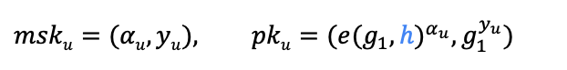
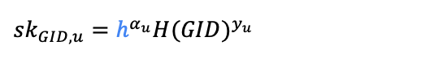
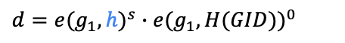
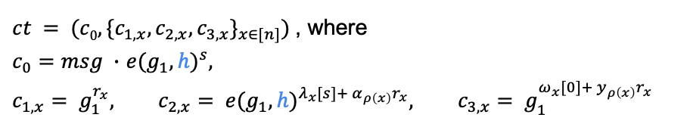
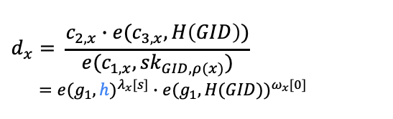
Our MA-ABE for BSP construction: step 1
$$msku=(αu, yu), pku=(e(g_{1}, h)^{α_{u}}, g_{1}^{y_{u}})$$
$$GlobalSetup(1κ)$$
$$Dec(ct,\{sk_{GID,ρ(x)}\}_{ρ(x)∈S})$$
$$gp = (N=p1p2p3, G,G_{T}, e, g1, h, H: \{0,1\}^{∗}→G)$$
$$d_{x}= \frac{c_{2,x}∙e(c_{3,x}, H\left(GID\right))}{e(c_{1,x}, {sk}_{GID,ρ(x)})} \\ =e(g_{1}, h)^{λ_{x}[s]}∙e(g_{1}, H(GID))^{ω_{x}[0]}$$
$$AuthSetup(gp, u)$$
choose random $αu, yu$in $ZN$
$$KGen(msk_{u}, GID)$$
$$Reconstruct$$
$$sk_{GID,u}=h^{α_{u}}H(GID)^{y_{u}}$$
$$d=e(g_{1}, h)^{s}∙e(g_{1}, H(GID))^{0}$$
$$Enc((M∈Z_{N}^{n ×l}, ρ), msg∈G_{T})$$
choose random $s$ in $ZN$
$$Share((M, ρ), s)→λ1, …, λn$$
$$Share((M, ρ), 0)→ω1, …,ωn$$
$$msg=\frac{c_{0}}{d}$$
$ct = (c0, \{c_{1,x},c_{2,x}, c_{3,x}\}_{x∈[n]})$ , where
$c_{0}=msg ∙$ $e(g_{1}, h)^{s}$,
$$c_{1,x}= g_{1}^{r_{x}}, c_{2,x}= e(g_{1}, h)^{λ_{x}[s]+ α_{ρ\left(x\right)}r_{x}}, c_{3,x}= g_{1}^{ω_{x}[0]+ y_{ρ\left(x\right)}r_{x}}$$
Notes:
Since h belongs to G, it gives us more entropy

Slide 36
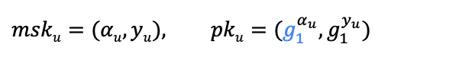
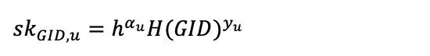
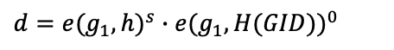
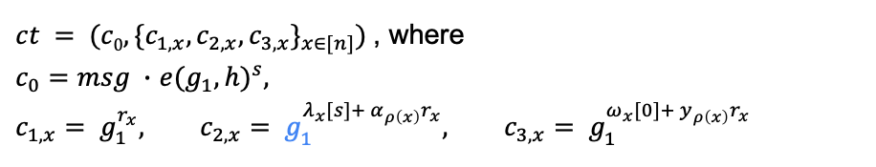
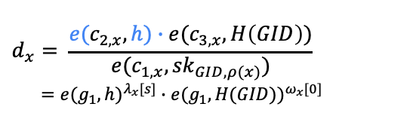
Our MA-ABE for BSP construction: step final
$$msku=(αu, yu), pku=(g_{1}^{α_{u}}, g_{1}^{y_{u}})$$
$$GlobalSetup(1κ)$$
$$Dec(ct,\{sk_{GID,ρ(x)}\}_{ρ(x)∈S})$$
$$gp = (N=p1p2p3, G,G_{T}, e, g1, h, H: \{0,1\}^{∗}→G)$$
$$d_{x}= \frac{{e(c}_{2,x},h)∙e(c_{3,x}, H\left(GID\right))}{e(c_{1,x}, {sk}_{GID,ρ(x)})} \\ =e(g_{1}, h)^{λ_{x}[s]}∙e(g_{1}, H(GID))^{ω_{x}[0]}$$
$$AuthSetup(gp, u)$$
choose random $αu, yu$in $ZN$
$$KGen(msk_{u}, GID)$$
$$Reconstruct$$
$$sk_{GID,u}=h^{α_{u}}H(GID)^{y_{u}}$$
$$d=e(g_{1}, h)^{s}∙e(g_{1}, H(GID))^{0}$$
$$Enc((M∈Z_{N}^{n ×l}, ρ), msg∈G_{T})$$
choose random $s$ in $ZN$
$$Share((M, ρ), s)→λ1, …, λn$$
$$Share((M, ρ), 0)→ω1, …,ωn$$
$$msg=\frac{c_{0}}{d}$$
$ct = (c0, \{c_{1,x},c_{2,x}, c_{3,x}\}_{x∈[n]})$ , where
$c_{0}=msg ∙$ $e(g_{1}, h)^{s}$,
$$c_{1,x}= g_{1}^{r_{x}}, c_{2,x}= g_{1}^{λ_{x}[s]+ α_{ρ\left(x\right)}r_{x}}, c_{3,x}= g_{1}^{ω_{x}[0]+ y_{ρ\left(x\right)}r_{x}}$$
Notes:
since the only step in [LW11a] that relies on a target-group-based computational assumption is the final transition – which our proof replaces with information-theoretic transition – we no longer need to embed the secret shares of s in the target group

Slide 37
1
Lewko-Waters MA-ABE for BSP
Limitations in supporting adaptive authority corruption
2
Security Analysis
3
Our MA-ABE for ASP
Notes:
Section 0: 12:00 min.
Section 1: 29:00 min (17:00 min).
Section 2: 34:00 min (4:30 min).
Section 3: 59:00 min (25 min).

Slide 38
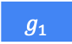
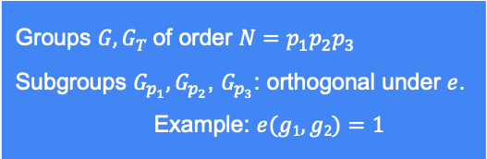
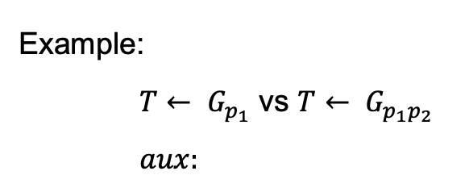
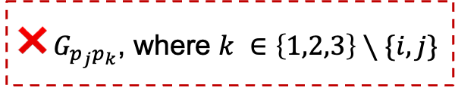
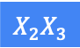
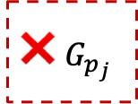
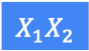
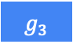
Subgroup Decision (SD) Assumption
Given $aux$, distinguish $T← G_{p_{i}}$ from $T← G_{p_{i}p_{j}}$, where $i,j ∈\{1,2,3\}$ and $i≠j$
Groups $G, G_{T}$of order $N=p_{1}p_{2}p_{3}$ Subgroups $G_{p_{1}},G_{p_{2}}$, $G_{p_{3}}$: orthogonal under $e$. Example: $e(g1, g2)=1$
❌ $G_{p_{j}}$
❌$G_{p_{j}p_{k}}$, where $k ∈\left\{1,2,3\right\}∖\{i,j\}$
Example:
$T← G_{p_{1}}$ vs $T← G_{p_{1}p_{2}}$
$aux:$
$$g_{1}$$
$$g_{3}$$
$$X_{1}X_{2}$$
$$X_{2}X_{3}$$

Slide 39
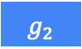
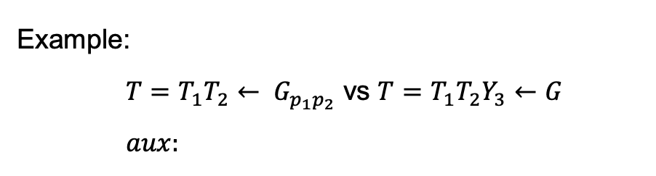



Subgroup Decision (SD) Assumption
Given $aux$, distinguish $T← G_{p_{i}p_{j}}$ from $T←G$, where $i,j ∈\{1,2,3\}$ and $i≠j$
Groups $G, G_{T}$of order $N=p_{1}p_{2}p_{3}$ Subgroups $G_{p_{1}},G_{p_{2}}$, $G_{p_{3}}$: orthogonal under $e$. Example: $e(g1, g2)=1$
❌$G_{p_{k}}$, where $k ∈\left\{1,2,3\right\}∖\{i,j\}$
Example:
$T=T_{1}T_{2}← G_{p_{1}p_{2}}$ vs $T=T_{1}T_{2}Y_{3}←G$
$aux:$
$$g_{1}$$
$$g_{2}$$
$$X_{1}X_{3}$$
$$Z_{2}Z_{3}$$

Slide 40








Our New Subgroup Decision (SD) Assumption
Given $aux$, distinguish $T=T_{1}T_{2}← G_{p_{1}p_{2}}$from$T=T_{1}T_{2}X_{3}←G$
$aux:$
$$g_{1}$$
$$g_{2}$$
$$X_{1}X_{3}$$
$$Z_{2}Z_{3}$$
Groups $G, G_{T}$of order $N=p_{1}p_{2}p_{3}$ Subgroups $G_{p_{1}},G_{p_{2}}$, $G_{p_{3}}$: orthogonal under $e$. Example: $e(g1, g2)=1$
Claim: reduces to the standard SD assumption
Proof:
$$\left(aux, T_{1}T_{2}\right)$$
$$≈_{c}$$
$$\left(aux, T_{1}T_{2}Y_{3}\right)$$
$≡$
$$(aux, {{(U}_{1}X}_{1})T_{2}{(U_{3}X}_{3})=(U_{1}T_{2}U_{3})X_{1}X_{3})$$
$$≈_{c}$$
$$(aux, {\left(U_{1}T_{2}\right)X_{1}X_{3}=T}_{1}T_{2}X_{3})$$
$$SD$$
Why?
A different abstraction to build intuition of our security proof
$$SD$$

Slide 41








Full Adaptive Security
global params
$$b∈\{0,1\}$$
$$AuthSetup(u) / KGen(u, GID) / Corrupt(u)$$
$$Enc(msg_{0}, msg_{1}, policy)$$
$${msg}_{b}$$
Admissibility:
For each GID,
issued keys + corrupt authorities do NOT satisfy the challenge
ciphertext-policy
$$policy$$
$$AuthSetup(u) / KGen(u, GID) / Corrupt(u)$$
$$b′$$
Adv wins if $b=b’$
Notes:
In this work, we consider full adaptive corruption security. Intuitively, this means the following. At the beginning of the game, the adversary obtains global params from the challenger.
After this, adversary can make following kinds of queries in arbitrary order: Authority Setup, Key Gen, Corruption and obtain respective responses immediately.
Then, it can make a challenge encryption query consisting of two messages msg0 and msg1 along with a challenge ciphertext-policy, and obtain a ciphertext encrypting msg_b, where b is the challenge bit.
After this, adversary can repeat queries like before, and eventually output a guess bit b’. Adv wins if b=b’, subject to the admissibility criteria:…
4:00

Slide 42









Hybrids
$Hyb0$ :
$$c0$$
$$e(g_{1}, h)^{s}$$
$$g_{1}^{r_{x}}$$
$$g_{1}^{λ_{x}[s]+ α_{ρ\left(x\right)}r_{x}}$$
$$g_{1}^{ω_{x}[0]+ y_{ρ\left(x\right)}r_{x}}$$
$$h^{α_{u}}$$
$$∙$$
$$c_{1,x}$$
$$H(GID)^{y_{u}}=h^{{z_{GID}∙y}_{u}}$$
$$c_{2,x}$$
$$sk_{GID,u}$$
$$c_{3,x}$$

Slide 43

Hybrids
$Hyb0$ :
$$c0$$
$$e(g_{1}, h)^{s}$$
$$g_{1}^{r_{x}}$$
$$g_{1}^{λ_{x}[s]+ α_{ρ\left(x\right)}r_{x}}$$
$$g_{1}^{ω_{x}[0]+ y_{ρ\left(x\right)}r_{x}}$$
$$H(GID)^{y_{u}}=h^{{z_{GID}∙y}_{u}}$$
$$c_{1,x}$$
$$sk_{GID,u}$$
$$c_{2,x}$$
$$c_{3,x}$$

Slide 44


Hybrids
$Hyb0$ :
$$c0$$
$$s$$
$$r_{x}$$
$$λ_{x}[s]$$
$$ω_{x}[0]$$
$${z_{GID}∙y}_{u}$$
$$c_{1,x}$$
$$sk_{GID,u}$$
$$c_{2,x}$$
$$c_{3,x}$$
Notes:
If less time, skip next 4 slides

Slide 45








Hybrids
$$0→1→2→3→4→5→6→7$$
$Hyb0$ :
$$c0$$
$$s$$
$$r_{x}$$
$$λ_{x}[s]$$
$$ω_{x}[0]$$
$${z_{GID}∙y}_{u}$$
$$c_{1,x}$$
$$sk_{GID,u}$$
$$c_{2,x}$$
$$c_{3,x}$$
$Hyb1$ :
✅
$${z_{GID, 1}∙y}_{u}$$
$$sk_{GID,u}$$
$${SD: G →G}_{p_{1}}$$
❌ $G_{p_{2}}$
❌ $G_{p_{3}}$
❌$G_{p_{2}p_{3}}$
$Hyb_{0} ≈_{c} Hyb_{1}$ if:
Notes:
If less time, skip this + next 3 slides

Slide 46













Hybrids
$$0→1→2→3→4→5→6→7$$
$Hyb1$ :
$$c0$$
$$s$$
$$r_{x}$$
$$λ_{x}[s]$$
$$ω_{x}[0]$$
$${z_{GID, 1}∙y}_{u}$$
$$c_{1,x}$$
$$sk_{GID,u}$$
$$c_{2,x}$$
$$c_{3,x}$$
$Hyb2$ :
$$c0$$
$$s$$ |  | $$s^{′′}$$
$$r_{x}$$ |  | $$r_{x}^{′′}$$
$$λ_{x}[s]$$ |  | $$λ_{x}^{′′} [s^{′′}]$$
$$ω_{x}[0]$$ |  | $$ω_{x}^{′′} [0]$$
✅
$$c_{1,x}$$
$$c_{2,x}$$
$$c_{3,x}$$
${SD: G}_{p_{1}}→ G_{p_{1}p_{3}}$
❌ $G_{p_{3}}$
❌$G_{p_{2}p_{3}}$
$Hyb_{1} ≈_{c} Hyb_{2}$ if:
Notes:
If less time, skip this + next 2 slides

Slide 47






Hybrids
$$0→1→2→3→4→5→6→7$$
$Hyb2$ :
$$c0$$
$$s$$ |  | $$s^{′′}$$
$$r_{x}$$ |  | $$r_{x}^{′′}$$
$$λ_{x}[s]$$ |  | $$λ_{x}^{′′} [s^{′′}]$$
$$ω_{x}[0]$$ |  | $$ω_{x}^{′′} [0]$$
$${z_{GID, 1}∙y}_{u}$$
$$c_{1,x}$$
$$sk_{GID,u}$$
$$c_{2,x}$$
$$c_{3,x}$$
$Hyb3$ :
$$c0$$
 |  | $$ω_{x}^{′′} [w^{′′}]$$
✅
✅
✅
$$c_{1,x}$$
✅
✅
$$c_{2,x}$$
✅
✅
$$c_{3,x}$$
✅
$Hyb_{2} ≡Hyb_{3}$ since corrupts rows unauthorized to decrypt and
$y_{ρ\left(x\right)} mod p_{3}$ information-theoretically hidden
Notes:
If less time, skip this + next 1 slides.
Why did we change \omega to be secret shares of a random value w’’ in p3 subgroup? Looking ahead, this will be crucial for our information-theoretic last step and I will explain why when we get there.

Slide 48








Hybrids
$$0→1→2→3→4→5→6→7$$
$Hyb3$ :
$$c0$$
$$s$$ |  | $$s^{′′}$$
$$r_{x}$$ |  | $$r_{x}^{′′}$$
$$λ_{x}[s]$$ |  | $$λ_{x}^{′′} [s^{′′}]$$
$$ω_{x}[0]$$ |  | $$ω_{x}^{′′} [w^{′′}]$$
$${z_{GID, 1}∙y}_{u}$$
$$c_{1,x}$$
$$sk_{GID,u}$$
$$c_{2,x}$$
$$c_{3,x}$$
$Hyb4$ :
$$c0$$
 | $$s^{′}$$
 | $$r_{x}^{′}$$
 | $$λ_{x}^{′} [s^{′}]$$
 | $$ω_{x}^{′} [0]$$
✅
✅
✅
$$c_{1,x}$$
✅
✅
$$c_{2,x}$$
✅
✅
$$c_{3,x}$$
✅
✅
${SD: G}_{p_{1}}→ G_{p_{1}p_{2}}$
❌ $G_{p_{2}}$
❌$G_{p_{2}p_{3}}$
$Hyb_{3} ≈_{c} Hyb_{4}$ if:
Notes:
If less time, skip this slide

Slide 49














Hybrids
$$0→1→2→3→4→5→6→7$$
$Hyb0$ :
$$c0$$
$$s$$
$$r_{x}$$
$$λ_{x}[s]$$
$$ω_{x}[0]$$
$${z_{GID}∙y}_{u}$$
$$c_{1,x}$$
$$sk_{GID,u}$$
$$c_{2,x}$$
$$c_{3,x}$$
$Hyb_{4}$ :
$$c0$$
$$s$$ | $$s^{′}$$ | $$s^{′′}$$
$$r_{x}$$ | $$r_{x}^{′}$$ | $$r_{x}^{′′}$$
$$λ_{x}[s]$$ | $$λ_{x}^{′} [s^{′}]$$ | $$λ_{x}^{′′} [s^{′′}]$$
$$ω_{x}[0]$$ | $$ω_{x}^{′} [0]$$ | $$ω_{x}^{′′} [w^{′′}]$$
$${z_{GID, 1}∙y}_{u}$$
$$c_{1,x}$$
$$sk_{GID,u}$$
$$c_{2,x}$$
$$c_{3,x}$$
$Hyb_{0} ≈_{c} Hyb_{4}$ if:
$${SD: G →G}_{p_{1}}$$
❌ $G_{p_{2}}$, ❌ $G_{p_{3}}$, ❌$G_{p_{2}p_{3}}$
${SD: G}_{p_{1}}→ G_{p_{1}p_{3}}$
❌ $G_{p_{3}},$❌$G_{p_{2}p_{3}}$
${SD: G}_{p_{1}}→ G_{p_{1}p_{2}}$
❌ $G_{p_{2}}$, ❌$G_{p_{2}p_{3}}$
Notes:
Why did we change \omega to be secret shares of a random value w’’ in p3 subgroup? Looking ahead, this will be crucial for our information-theoretic last step and I will explain why when we get there.

Slide 50








Hybrids
$$0→1→2→3→4→5→6→7$$
$Hyb4$ :
$$c0$$
$$s$$ | $$s^{′}$$ | $$s^{′′}$$
$$r_{x}$$ | $$r_{x}^{′}$$ | $$r_{x}^{′′}$$
$$λ_{x}[s]$$ | $$λ_{x}^{′} [s^{′}]$$ | $$λ_{x}^{′′} [s^{′′}]$$
$$ω_{x}[0]$$ | $$ω_{x}^{′} [0]$$ | $$ω_{x}^{′′} [w^{′′}]$$
$${z_{GID, 1}∙y}_{u}$$
$$c_{1,x}$$
$$sk_{GID,u}$$
$$c_{2,x}$$
$$c_{3,x}$$
$Hyb5$ :
$${z_{GID, 1}∙y}_{u}$$ |  | $${c∙y}_{u}$$
✅
${SD: G}_{p_{1}}→ G_{p_{1}p_{2}}$
❌ $G_{p_{2}}$
❌$G_{p_{2}p_{3}}$
$New$ $SD:G_{p_{1}p_{2}}→G$
❌ $G_{p_{3}}$
$Hyb_{4} ≈_{c} Hyb_{5}$ if:

Slide 51





Hybrids
$$0→1→2→3→4→5→6→7$$
$Hyb5$ :
$$c0$$
$$s$$ | $$s^{′}$$ | $$s^{′′}$$
$$r_{x}$$ | $$r_{x}^{′}$$ | $$r_{x}^{′′}$$
$$λ_{x}[s]$$ | $$λ_{x}^{′} [s^{′}]$$ | $$λ_{x}^{′′} [s^{′′}]$$
$$ω_{x}[0]$$ | $$ω_{x}^{′} [0]$$ | $$ω_{x}^{′′} [w^{′′}]$$
$${z_{GID, 1}∙y}_{u}$$ |  | $${c∙y}_{u}$$
$$c_{1,x}$$
$$sk_{GID,u}$$
$$c_{2,x}$$
$$c_{3,x}$$
$Hyb6$ :
$$c0$$
 |  | $$λ_{x}^{′′} [t^{′′}]$$
✅
✅
✅
✅
$$c_{1,x}$$
✅
✅
✅
$$c_{2,x}$$
✅
✅
$$c_{3,x}$$
✅
✅
✅
$Hyb_{5} ≡Hyb_{6}$ since corrupts rows unauthorized to decrypt and the structure of user secret keys

Slide 52






Hybrids
$$0→1→2→3→4→5→6→7$$
$$α_{u}$$
$$+$$
$Hyb5$ :
$$c0$$
$$s$$ | $$s^{′}$$ | $$s^{′′}$$
$$r_{x}$$ | $$r_{x}^{′}$$ | $$r_{x}^{′′}$$
$$λ_{x}[s]$$ | $$λ_{x}^{′} [s^{′}]$$ | $λ_{x}^{′′} [s^{′′}]$ + $α_{ρ\left(x\right)}r_{x}^{′′}$
$$ω_{x}[0]$$ | $$ω_{x}^{′} [0]$$ | $ω_{x}^{′′} [w^{′′}]$ + $y_{ρ\left(x\right)}r_{x}^{′′}$
$${z_{GID, 1}∙y}_{u}$$ |  | $${c∙y}_{u}$$
$$c_{1,x}$$
$$sk_{GID,u}$$
$$c_{2,x}$$
$α_{u}+c∙y_{u} mod p_{3}$
information-theoretically revealed
$$c_{3,x}$$
$Hyb6$ :
$$c0$$
 |  | $λ_{x}^{′′} [t^{′′}]$ + $α_{ρ\left(x\right)}r_{x}^{′′}$
 |  | $ω_{x}^{′′} [v^{′′}]$ + $y_{ρ\left(x\right)}r_{x}^{′′}$
✅
✅
✅
$α_{ρ(x) }→α_{ρ(x) }−Δ$, $y_{ρ(x) }→y_{ρ(x) }+Δ/c,$
where $Δ=\frac{t}{r_{x}^{′′}} M_{x}∙a$,
$a$ : orthogonal to corrupt rows,
$t$ : uniform random
$$c_{1,x}$$
✅
✅
✅
$$c_{2,x}$$
✅
✅
$$c_{3,x}$$
✅
✅
$t^{′′}=s^{′′}−t ∙a_{1}, v^{′′}=w^{′′}+\frac{t}{c}∙a_{1}$
$Hyb_{5} ≡Hyb_{6}$ since corrupts rows unauthorized to decrypt and the structure of user secret keys
Notes:
T’’ breaks co-relation from s’’ in p3 subgroup of c0.
V’’ and w’’ are identically distributed since w’’ is uniform random.

Slide 53




$λ_{x}^{′′} \left[s^{′′}\right]=M_{x}∙v,$where $v=(s^{′′}, v_{2}, …, v_{n})$
$λ_{x}^{′′} \left[s^{′′}\right]+α_{ρ\left(x\right)}r_{x}^{′′}→$ $λ_{x}^{′′} \left[s^{′′}\right]+\left(α_{ρ\left(x\right)}−Δ\right)r_{x}^{′′}$, where
$$λ_{x}^{′′} \left[s^{′′}\right]+\left(α_{ρ\left(x\right)}−Δ\right)r_{x}^{′′}$$
$$=λ_{x}^{′′} \left[s^{′′}\right]−Δ{ r}_{x}^{′′}+α_{ρ\left(x\right)}r_{x}^{′′}$$
$$=M_{x}∙v−M_{x}∙t∙a+α_{ρ\left(x\right)}r_{x}^{′′}$$
$$=M_{x}∙(v−t∙a)+α_{ρ\left(x\right)}r_{x}^{′′}$$
$=λ_{x}^{′′} \left[t^{′′}\right]+α_{ρ\left(x\right)}r_{x}^{′′}$, where
$v−t∙a=(s^{′′}−t{∙a}_{1}, v_{2}−t{∙a}_{2}, …, v_{n}−t{∙a}_{n})$
$$t^{′′}$$
$α_{ρ(x) }→α_{ρ(x) }−Δ$, $y_{ρ(x) }→y_{ρ(x) }+Δ/c,$
where $Δ=\frac{t}{r_{x}^{′′}} M_{x}∙a$,
$a$ : orthogonal to corrupt rows,
$t$ : uniform random
$ω_{x}^{′′} \left[w^{′′}\right]=M_{x}∙w,$where $w=(w^{′′}, w_{2}, …, w_{n})$
$ω_{x}^{′′} \left[w^{′′}\right]+y_{ρ\left(x\right)}r_{x}^{′′}→ω_{x}^{′′} \left[w^{′′}\right]+{(y}_{ρ\left(x\right)}+Δ/c)r_{x}^{′′}$, where
$$ω_{x}^{′′} \left[w^{′′}\right]+{(y}_{ρ\left(x\right)}+Δ/c)r_{x}^{′′}$$
$$=M_{x}∙(w+t/c∙a)+y_{ρ\left(x\right)}r_{x}^{′′}$$
$=ω_{x}^{′′} \left[v^{′′}\right]+y_{ρ\left(x\right)}r_{x}^{′′}$, where
$$w+\frac{t}{c}∙a=(w^{′′}+\frac{t}{c}∙a_{1}, w_{2}+{\frac{t}{c}∙a}_{2}, …, w_{n}+\frac{t}{c}∙a_{n})$$
$t^{′′}=s^{′′}−t ∙a_{1}, v^{′′}=w^{′′}+\frac{t}{c}∙a_{1}$
$$v^{′′}$$
Notes:
T’’ breaks co-relation from s’’ in p3 subgroup of c0.
V’’ and w’’ are identically distributed since w’’ is uniform random.

Slide 54





Hybrids
$$0→1→2→3→4→5→6→7$$
$Hyb6$ :
$$c0$$
$$s$$ | $$s^{′}$$ | $$s^{′′}$$
$$r_{x}$$ | $$r_{x}^{′}$$ | $$r_{x}^{′′}$$
$$λ_{x}[s]$$ | $$λ_{x}^{′} [s^{′}]$$ | $$λ_{x}^{′′} [t^{′′}]$$
$$ω_{x}[0]$$ | $$ω_{x}^{′} [0]$$ | $$ω_{x}^{′′} [v^{′′}]$$
$${z_{GID, 1}∙y}_{u}$$ |  | $${c∙y}_{u}$$
$$c_{1,x}$$
$$sk_{GID,u}$$
$$c_{2,x}$$
$$c_{3,x}$$
$Hyb7$ :
$c0$ encodes uniform random message
$Hyb_{6} ≡Hyb_{7}$ using entropy of $s^{′′} mod p_{3}$ since it is information-theoretically hidden

Slide 55
1
Lewko-Waters MA-ABE for BSP
Limitations in supporting adaptive authority corruption
2
Security Analysis
3
Our MA-ABE for ASP
Notes:
Section 0: 12:00 min.
Section 1: 29:00 min (17:00 min).
Section 2: 34:00 min (4:30 min).
Section 3: 59:00 min (25 min).

Slide 56

Arithmetic Span Program (ASP)
Universe of attributes: $U$ ASP over $Zq$: $(M,N, ρ)$, where matricies $M, N ∈ Zqn x ℓ$, map $ρ: [n]→U$ $z∈Z_{q}^{|S|}$ satisfies $(M, N, ρ)$ iff $(1, 0, …, 0)∈RowSpan(\{z_{ρ\left(x\right)}M_{x}+N_{x}\}_{x ∈ S})$

Slide 57




Our MA-ABE for ASP construction
$$msku=(αu, yu), pku=(g_{1}^{α_{u}}, g_{1}^{y_{u}})$$
$$GlobalSetup(1κ)$$
$$Dec(ct,\{sk_{GID,ρ(x)}\}_{ρ(x)∈S})$$
$$gp = (N=p1p2p3, G, GT, e, g1, h, H: \{0,1\}^{∗}→G)$$
$$d_{x}= \frac{{e(c}_{2,x},h)∙e(c_{3,x}, H\left(GID\right))}{e(c_{1,x}, {sk}_{GID,ρ(x)})} \\ =e(g_{1}, h)^{λ_{x}}∙e(g_{1}, H(GID))^{ω_{x}}$$
$$AuthSetup(gp, u)$$
choose random $αu, yu$in $ZN$
$$KGen(msk_{u}, GID)$$
$$Reconstruct$$
$$sk_{GID,u}=h^{α_{u}}H(GID)^{y_{u}}$$
$$d=e(g_{1}, h)^{s}∙e(g_{1}, H(GID))^{0}$$
$$Enc((M, ρ), msg∈G_{T})$$
choose random $s$ in $ZN$
$$Share((M, ρ), s)→λ1, …, λn$$
$$Share((M, ρ), 0)→ω1, …,ωn$$
$$msg=\frac{c_{0}}{d}$$
$ct = (c0, \{c_{1,x},c_{2,x}, c_{3,x}\}_{x∈[n]})$ , where
$c_{0}=msg ∙$ $e(g_{1}, h)^{s}$,
$$c_{1,x}= g_{1}^{r_{x}}, c_{2,x}= g_{1}^{λ_{x}+ α_{ρ\left(x\right)}r_{x}}, c_{3,x}= g_{1}^{ω_{x}+ y_{ρ\left(x\right)}r_{x}}$$
Notes:
since the only step in [LW11a] that relies on a target-group-based computational assumption is the final transition – which our proof replaces with information-theoretic transition – we no longer need to embed the secret shares of s in the target group

Slide 58











Our MA-ABE for ASP construction
$$msku=({α_{u}, y_{u},α}_{u}^{′}, y_{u}^{′}), pku=(g_{1}^{α_{u}}, g_{1}^{y_{u}}, g_{1}^{α_{u}^{′}}, g_{1}^{y_{u}^{′}})$$
$$GlobalSetup(1κ)$$
$$Dec(ct,\{z_{ρ\left(x\right)}, sk_{GID,ρ(x)}\}_{ρ(x)∈S})$$
$$gp = (N=p1p2p3, G, GT, e, g1, h, H: \{0,1\}^{∗}→G)$$
$$d_{x}= \frac{e(c_{2, x}^{z_{ρ(x)}}c_{4,x},h)∙e(c_{3 x}^{z_{ρ(x)}}c_{5,x}, H\left(GID\right))}{e(c_{1,x}, {sk}_{GID,ρ(x)})}$$
$$=e(g_{1}, h)^{λ_{x}z_{ρ\left(x\right)}+λ_{x}^{′}}$$
$$∙e(g_{1}, H(GID))^{ω_{x}z_{ρ(x)}+ω_{x}^{′}}$$
$$AuthSetup(gp, u)$$
choose random ${α_{u}, y_{u},α}_{u}^{′}, y_{u}^{′}$in $ZN$
$$KGen(msk_{u}, GID, z_{u})$$
choose random $s$ in $ZN$
$Share((M, ρ), s)→λ1, …, λn$,
$Share((M, ρ), 0)→ω1, …,ωn$,
$Share((N ρ), s)→λ_{1}^{′}, …,λ_{n}^{′}$,
$$Share((N, ρ), 0)→ω_{1}^{′}, …,ω_{n}^{′}$$
$$sk_{GID,u}=h^{α_{u}z_{u}+α_{u}^{′}}H(GID)^{y_{u}z_{u}+y_{u}^{′}}$$
$$Reconstruct$$
$$Enc((M, N, ρ), msg∈G_{T})$$
$$d=e(g_{1}, h)^{s}∙e(g_{1}, H(GID))^{0}$$
$ct = (c0, \{c_{1,x},c_{2,x}, c_{3,x},c_{4,x}, c_{5,x}\}_{x∈[n]})$ , where
$c_{0}=msg ∙$ $e(g_{1}, h)^{s}$,
$$c_{1,x}= g_{1}^{r_{x}}, c_{2,x}= g_{1}^{λ_{x}+ α_{ρ\left(x\right)}r_{x}}, c_{3,x}= g_{1}^{ω_{x}+ y_{ρ\left(x\right)}r_{x}},$$
$c_{4,x}= g_{1}^{λ_{x}^{′}+α_{ρ(x)}^{′}r_{x}}, c_{5,x}=g_{1}^{ω_{x}^{′}+y_{ρ(x)}^{′}r_{x}}$
$$msg=\frac{c_{0}}{d}$$
Notes:
since the only step in [LW11a] that relies on a target-group-based computational assumption is the final transition – which our proof replaces with information-theoretic transition – we no longer need to embed the secret shares of s in the target group

